Slide 1


Introduction to the KY-038 Sound Sensor Module
This presentation will explore the KY-038 sound sensor module, a widely used component for sound detection in electronics projects. We'll cover its components, working principle, and how to interface it with microcontrollers like Arduino.
by swaraj upgrad

Slide 2
KY-038: Module Components and Pinout
Microphone
LM393 Comparator
Potentiometer
Resistors and Capacitors
An electret condenser microphone with -44dB ±2dB sensitivity, capturing sound waves and converting them into electrical signals.
A comparator chip (refer to the LM393 datasheet) that compares the microphone's analog signal to a reference voltage, generating a digital output based on the threshold.
Used to adjust the reference voltage for the comparator, controlling the sensitivity level. A higher voltage setting makes the sensor more sensitive.
These components are essential for signal conditioning, filtering unwanted noise, and ensuring stable operation.

Slide 3
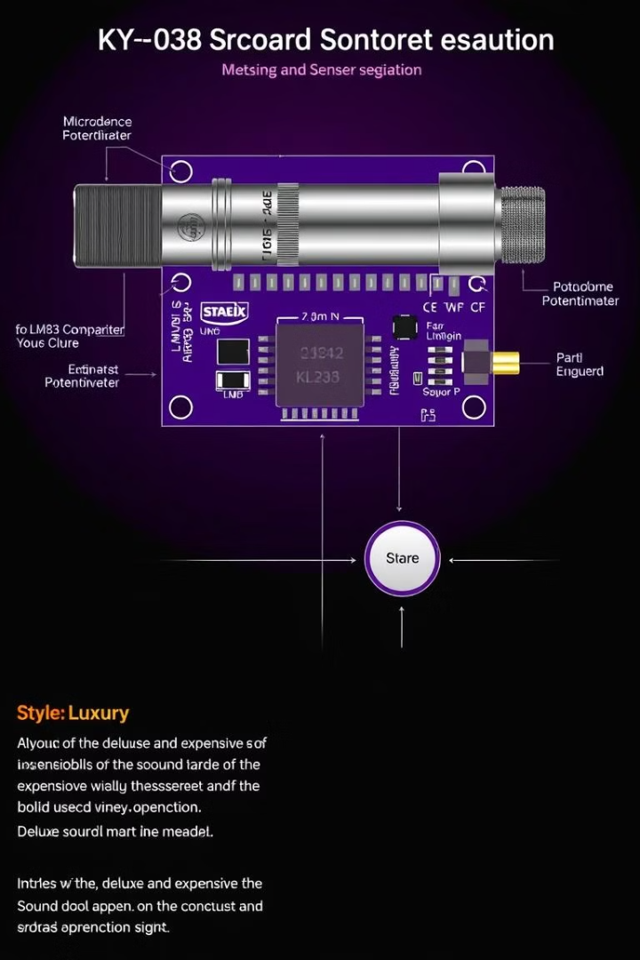
Working Principle: Sound Detection and Signal Conversion
1
The microphone captures sound waves and converts them into fluctuating electrical signals.
2
The LM393 comparator receives this analog signal and compares it to a reference voltage.
3
If the input signal exceeds the threshold set by the potentiometer, the comparator outputs a high signal.
4
If the signal falls below the threshold, the output becomes low. The absence of hysteresis might lead to chattering under certain conditions.

Slide 4




Sensitivity Adjustment with the Potentiometer
The potentiometer sets the reference voltage for the LM393 comparator.
A higher reference voltage means the sensor requires a stronger sound to trigger the digital output (less sensitive).
A lower reference voltage increases sensitivity, meaning the sensor will trigger with quieter sounds.

Slide 5
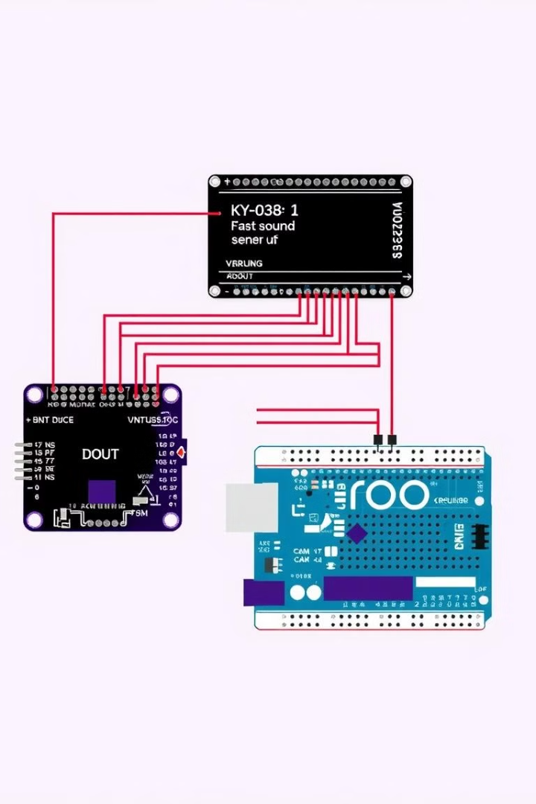



Interfacing with Microcontrollers (Arduino Example)
Connect VCC to 5V, GND to GND, and DOUT to a digital pin on your Arduino (e.g., pin 2).
Use `digitalRead(pin)` in your Arduino code to read the digital output from the sensor. Trigger actions based on the detected sound.
A simple example: Turn on an LED when sound is detected. You can modify the code to trigger various actions based on the sound level.

Slide 6
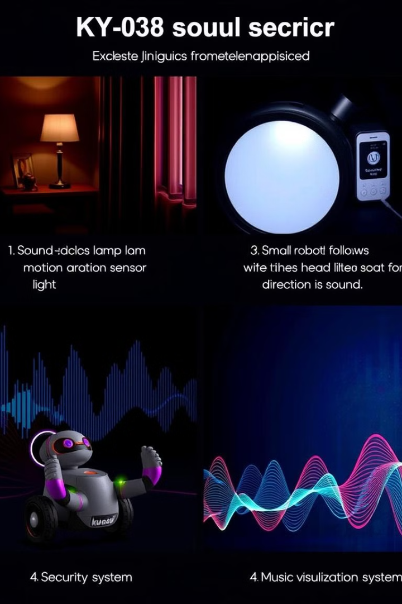
Applications of the KY-038 Sound Sensor
Sound-activated Switches
Control lights, fans, or other appliances based on the detection of sound. For example, turn on the lights when you clap your hands.
Security Systems
Detect unusual sounds and trigger alarms. For instance, you could create a glass break detection system to alert you if a window breaks.
Robotics
Use sound as a basic navigation guide or enable rudimentary voice command recognition in your robots.
Music Visualization
Create visual effects that react to the rhythm and volume of music, adding a dynamic element to your music listening experience.

Slide 7
Advantages and Disadvantages
Advantages
Disadvantages
Low cost: ~$2 per module
Limited frequency response: May not accurately detect very high or low frequencies
Ease of use: Simple digital output for basic sound detection
Sensitivity to ambient noise: Can be triggered by unwanted sounds
Adjustable sensitivity: Potentiometer for calibration
Wide availability: Widely sold and supported
Lack of precision: Not suitable for accurate sound level measurements (dB SPL)
Noisy output: Potential for false triggers due to electrical noise

Slide 8



Conclusion and Future Enhancements
Advanced Sound Analysis
1
Combine the sensor with other sensors like accelerometers for more complex sound event detection.
Noise Reduction
2
Implement filtering techniques to minimize false triggers caused by unwanted noise.
Frequency Analysis
3
Utilize the Fast Fourier Transform (FFT) library to analyze the sound frequencies for more sophisticated applications.

